Slide 1
Intro. to Natural Language Processing
Pree Thiengburanathum, PhD.

Slide 2
Agenda
Intro to unstructured data (NLP)
Workshop (approx. 1-3)
Case study 1

Slide 3
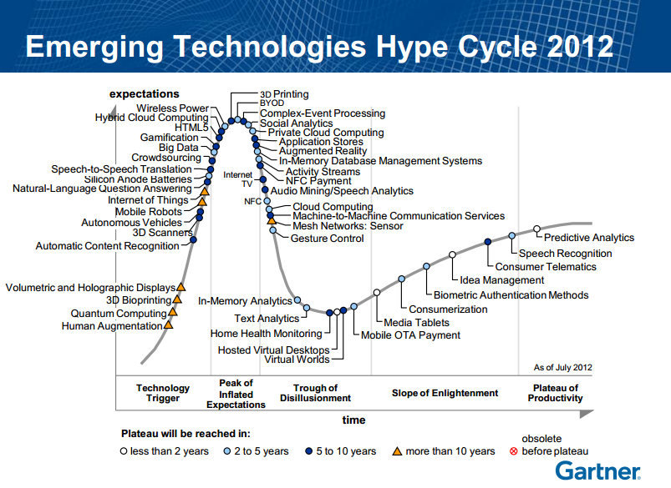

Slide 4
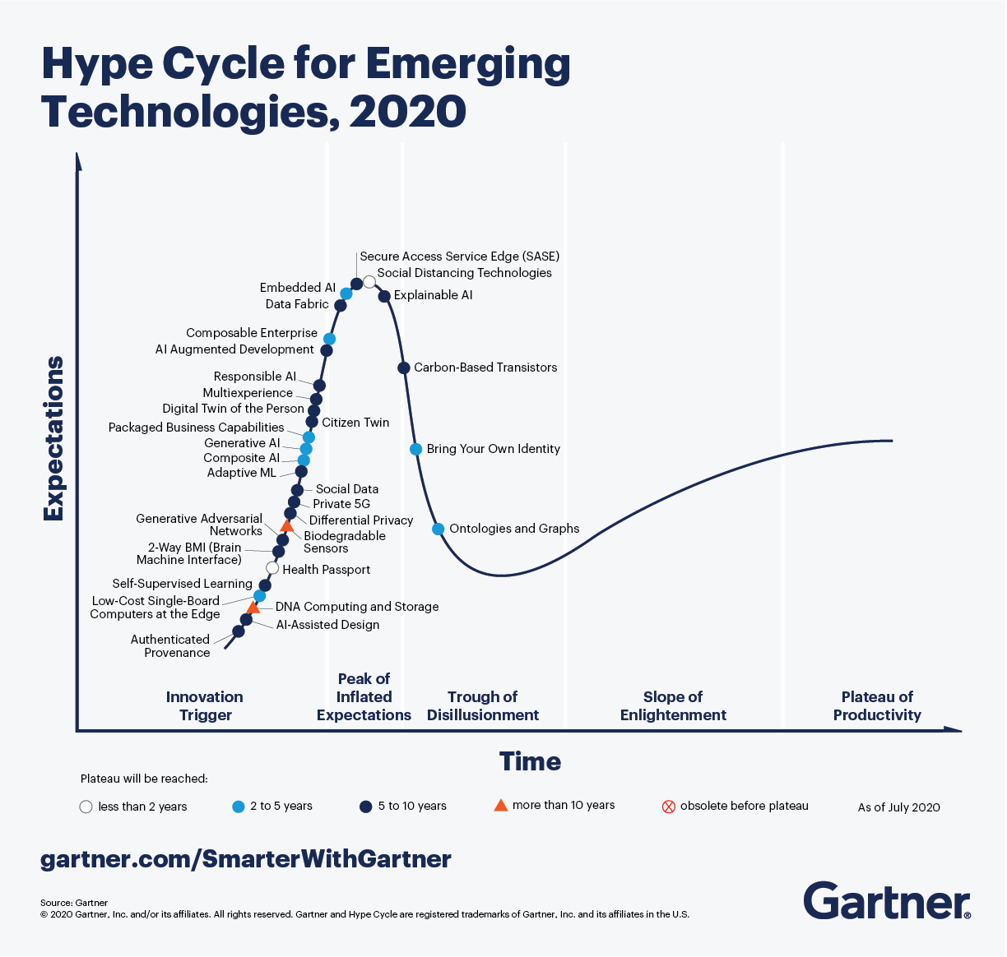

Slide 5
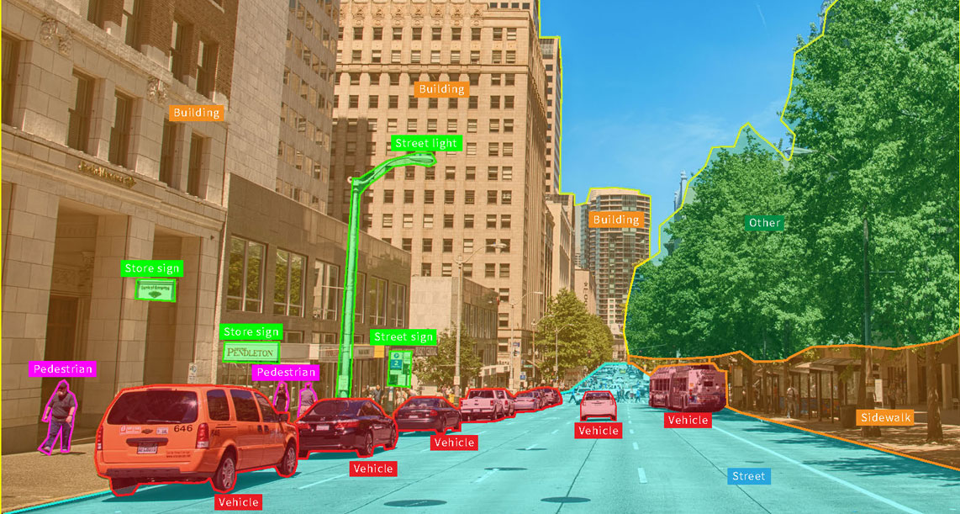
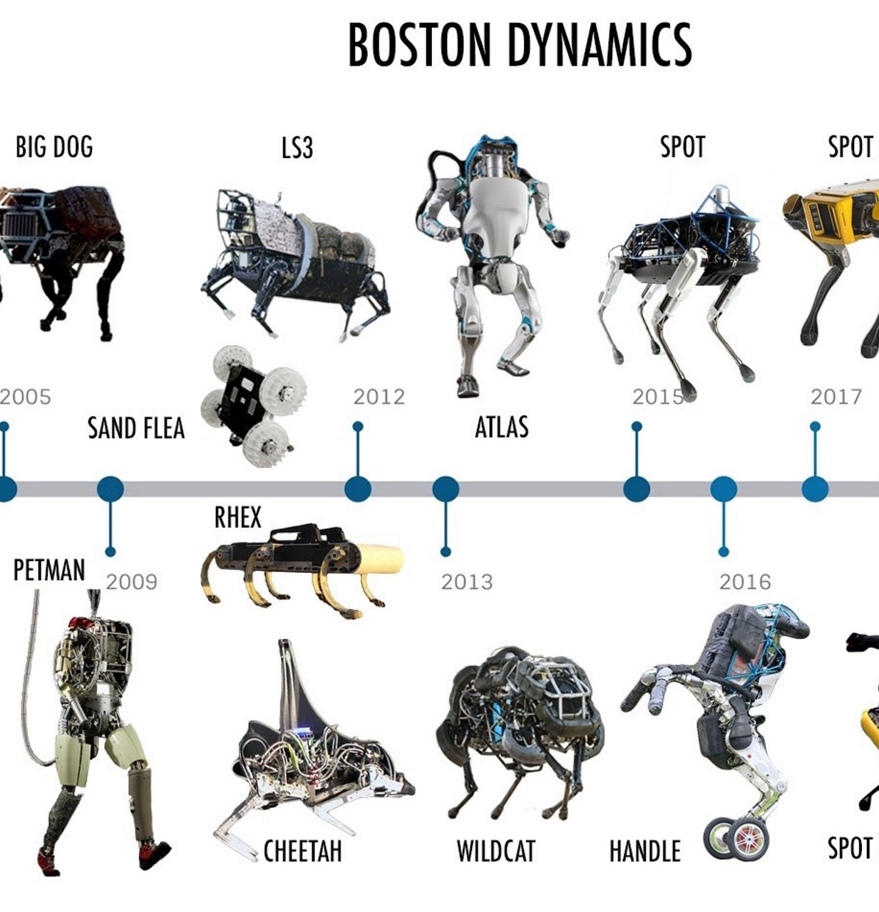
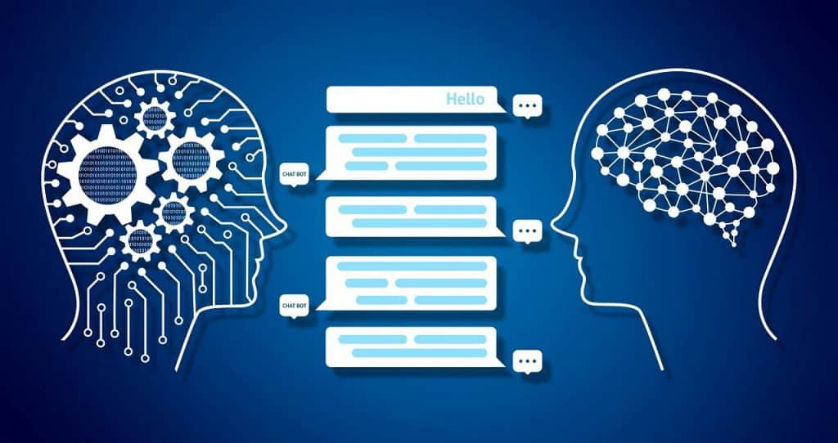
Modern Artificial Intelligence (AI)

Slide 6
Introduction (cont.)
Data continues to grow exponentially
Estimated to be 2.5 MTB a day
Grow to 40 BTB by 2020 (50 * of 2010)
Approx. 80% of data is estimated to be unstructured/text-rich data
>4.5 billion web pages
>40 million articles (5 million in English)
>500 million tweets a day, 200 billion a year
>1.5 trillion queries on Google a year

Slide 7
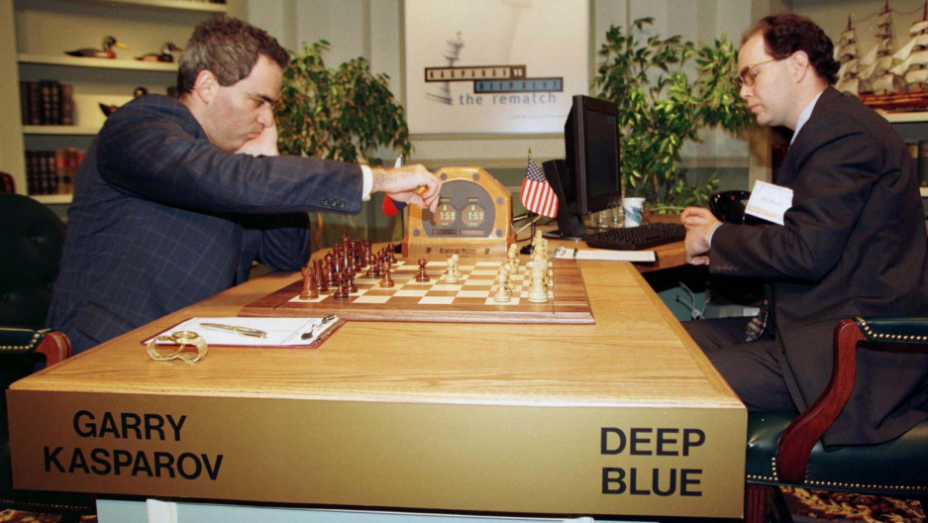
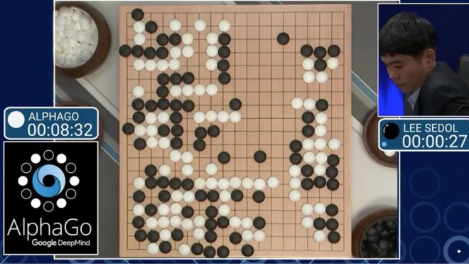

Machine Versus Men

Slide 8
Machine Versus Men (cont.)
Can machine beat the best of man in what man is supposed to be the best at?
https://www.youtube.com/watch?v=YgYSv2KSyWg
Watson, which is called DeepQA
Watson had access to 200 million pages of structured and unstructured content consuming four terabytes of disk storage.

Slide 9
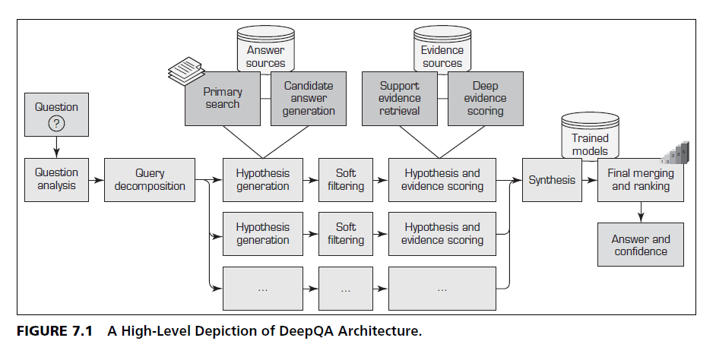
DeepQA overall architecture

Slide 10
Text Analytics
The vast majority of business data is stored in text documents that are virtually unstructured.
Text analytics is a broader concept that includes information retrieval (e.g., searching and identifying relevant documents for a given set of key terms) as well as information extraction, data mining, and Web mining,
Whereas text mining is primarily focused on discovering new and useful knowledge from the textual data sources.

Slide 11
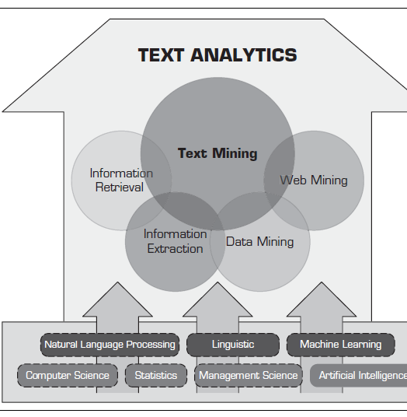
Text Analytics (cont.)
Top-down approach vs bottom up
Text Mining is a derivative of Data Mining.
Sentimental Analysis is a derivative of Text Mining.

Slide 12
Text Mining
AKA. Text data mining/knowledge discovery in textual database
Large amount of unstructured data
Word, PDF, XML, etc.
Benefit domains:
In the areas where very large amount of textual data are being generated.
Could you give some example?

Slide 13
Text Mining (cont.)
Law – court orders
Academic research – research article
Finance – quarterly report
Medicine – discharge summaries
Biology- molecular interactions
Marketing – customer comments
Social Science – Web board, Twitter , etc.
Technology – e-mail? Is Gmail the smartest?

Slide 14
Text Mining applications
Information extraction – identify the key phrases and relationship within text
Topic tracking – predict/recommend other document of interest to user.
Summarization – summarizing a document to save time of the reader.
Categorization – identify the main themes of a document and put to the right themes
Clustering – group similar documents without having a predefined set of categories
Concept linking – connects related documents by identify their shared concepts.
Question answering – find the best answer to a given question

Slide 15
Text Mining applications (cont.)
Intention mining/recognition/detection – discover user intention based on comments, reviews, tweets, blogs
Concept mining – extract idea and concept from large static social media
Sentiment Analysis – categorize text to sentiment polarity (pos, neg, neu)

Slide 16
Text mining terminologies
Unstructured data (versus structured data). – human readable
Corpus = dataset
Terms – single word or multiword pharse from corpus
Concepts – features generated from documents.
Stemming – process of reducing inflected word to their root
Stop words- words that are filtered out after processed.
Synonyms and polysemes – syntactically different/identical words
Tokenizing – block of text
Word frequency - #time that word occur in the document

Slide 17
Text mining terminologies (cont.)
Morphology – form and formation of words in a language
Morphemes – an element in word
Word frequency – the number of times a word is found

Slide 18
Intro Natural Language Processing (NLP)
Natural language vs Programming language
NL - human share information with human
PL – human tells machines what to do
NLP – Machine can now process natural language (i.e., interpreter)

Slide 19
Intro NLP (cont.)
Subfield of AI and Computation Intelligent/linguistics.
Try to understanding the natural human language.
Moving forward to syntax-drive (word counting) to true understanding and processing of NLP
Considering grammatical, semantic constraint and context.

Slide 20
NLP practical applications
Editing – spelling, grammar, style
Dialog – Chatbot, assistant, scheduling
Email – spam filter, classification, prioritization
Text mining – Summarization, knowledge extraction
News – event detection, fact checking, fake news detection
Attribution – plagiarism detection, literacy forensics,
Creative writing – Movie scripts, poetry, song lyrics.
Search- web, documents, autocomplete
Chatbot – Ambiguous commands, Q/A, scheduling

Slide 21
Intro Natural Language Processing (NLP)
Bag-of-words (classical method)
Text, sentences, paragraph, or document -> words
Classification model <spam/legitimate>
One bag is filled with words found in spam messages (Viagra, stock, buy)
Another bag is filed with words related to user’s friend or workplace.
Human do not use words without some order or structure
Semantic and syntactic structure
Text mining need to look for ways beyond the bag-of-words.

Slide 22
Challenge in NLP (non-practical)
Part of speech tagging (POS-tagging)- identify Adverb verb, noun in the sentence.
Text segmentation - Chinese/Thai/Other languages.
Word sense disambiguation – a word may has more than one meaning.
Syntactic ambiguity – grammar is ambiguous
Imperfect or irregular input – typos , grammar errors

Slide 23
Workshop 1- Business understanding
How would you apply NLP techniques or possible application into your interest business?
Discuss, stakeholders, data sci talks, output, outcome, and impact.

Slide 24
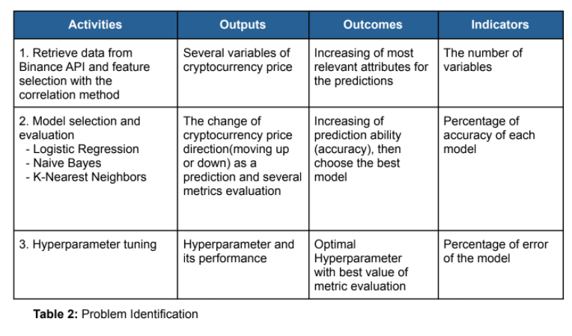
Example

Slide 25
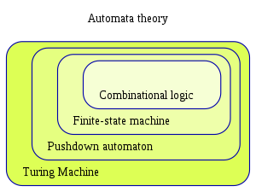
Regular expression/Regular grammar
Finite State Machine (FSM) /Deterministic finite automation (DFA)
However, Natural Language ..
Are not regular (rules)
Are not context –free (pattern of string)
Can’t be defined by any formal grammar.

Slide 26
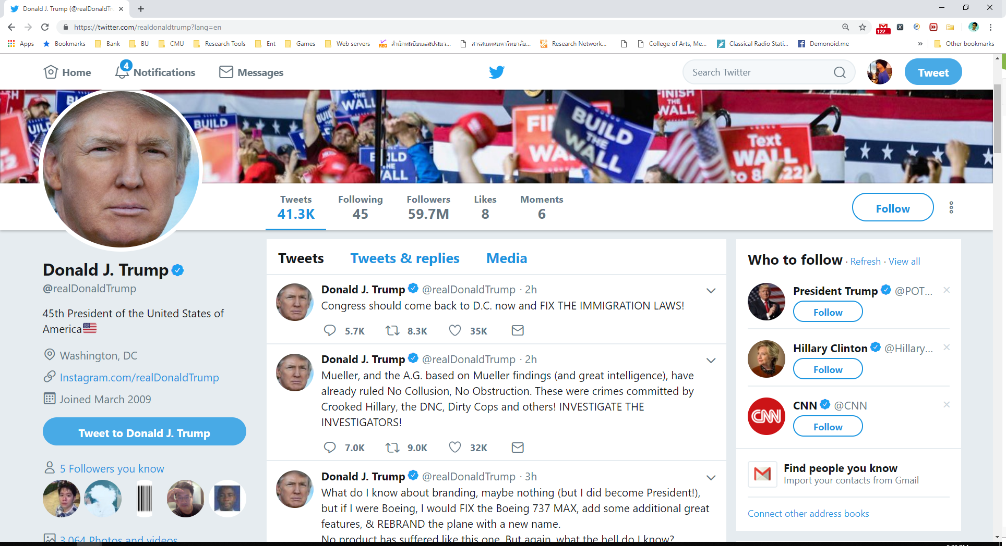
Data hidden in text

Slide 27
Handling Text in Python
>>> txt1 = 'The Radical Left Democrats will never be satisfied with anything we give them. They will always Resist and Obstruct!’
>>> len(txt1)
116
>>> txt2 = txt1.split(' ');
>>> len(txt2);
19
>>> txt2
['The', 'Radical', 'Left', 'Democrats', 'will', 'never', 'be', 'satisfied', 'with', 'anything', 'we', 'give', 'them.', 'They', 'will', 'always', 'Resist', 'and', 'Obstruct!']
>>>

Slide 28
Handling Text in Python (cont.)
Finding long words: e.g. words that has more than 3 letters.
>>> [w for w in txt2 if len(w) > 3]
['Radical', 'Left', 'Democrats', 'will', 'never', 'satisfied', 'with', 'anything', 'give', 'them.', 'They', 'will', 'always', 'Resist', 'Obstruct!’]
Finding capitalized words:
>>> [w for w in txt2 if w.istitle()]
['The', 'Radical', 'Left', 'Democrats', 'They', 'Resist', 'Obstruct!']

Slide 29
Handling Text in Python (cont.)
Find words which ends with ‘s’:
>>> [w for w in txt2 if w.endswith('s')]
['Democrats', 'always’]
Find unique words: using set():
>>> txt3 = 'To be or not to be’
>>> txt4 = txt3.split(' ‘)
>>> len(txt4)
6
>>> len(set(txt4))
5
>>> set(txt4)
{'be', 'not', 'to', 'To', 'or'}

Slide 30
Handling Text in Python (cont.)
>>> set([w.lower() for w in txt4])
{'be', 'not', 'or', 'to'}
>>>

Slide 31
Handling Text in Python (cont.)
Word comparation in Python
s.startswith(t)
s.endswith(t)
t in s
s.istitle()
s.islower()
s.isupper()
s.isdigit(), s.isalnum(), s.isalpha()

Slide 32
String operations
s.lower(); s.upper(); s.titlecase()
s.splits()
s.splitlines()
s.join(t) //
s.strip() // take out all the white space
s.find(t)// find the specific substring
s.replace(u, v)// u will be replace by v

Slide 33
Words to characters
>>> txt5 = 'ouagadougou'
>>> txt6 = txt5.split('ou')
>>> txt6
['', 'agad', 'g', ‘’]
>>> 'ou'.join(txt6)
'ouagadougou'

Slide 34
Words to characters (cont.)
>>> txt5.split('')
Traceback (most recent call last):
File "<pyshell#7>", line 1, in <module>
txt5.split('')
ValueError: empty separator
>>> list(txt5)
>> [c for in c txt5]
['o', 'u', 'a', 'g', 'a', 'd', 'o', 'u', 'g', 'o', 'u']

Slide 35
Cleaning text
>>> txt8 = ' A quick brown fox jumped over the lazy dog. '
>>> txt8.split(' ')
['', ‘’, '\t', 'A', 'quick', 'brown', 'fox', 'jumped', 'over', 'the', 'lazy', 'dog.', ‘’]
>>> txt8.strip()
'A quick brown fox jumped over the lazy dog.'

Slide 36
Changing text
>>> txt9 = txt8.strip()
>>> txt9
'A quick brown fox jumped over the lazy dog.'
>>> txt9.find('o')
10
>>> txt9.rfind('o')
40
>>> txt9.replace('o', 'O')
'A quick brOwn fOx jumped Over the lazy dOg.'

Slide 37
Handling larger texts
Reading files line by line
>>> f = open('/Users/Pree/Desktop/notre dame.txt')
>>> f.readline()
'Notre-Dame de Paris, often referred to simply as Notre-Dame, is a medieval Catholic cathedral on the ÃŽle de la CitÃ© in the 4th arrondissement of Paris, France.\n'
Reading the full file
>>> f.seek(0)
0
>>> txt12 = f.read()
>>> len(txt12)

Slide 38
Handling larger texts (cont.)
>>> txt13 = txt12.splitlines()
>>> len(txt13)
>>> txt13
['Notre-Dame de Paris, often referred to simply as Notre-Dame, is a medieval Catholic cathedral on the ÃŽle de la CitÃ© in the 4th arrondissement of Paris, France.', '', 'The cathedral is consecrated to the Virgin Mary and considered to be one of the finest examples of French Gothic architecture.']
>>> txt13[0]
'Notre-Dame de Paris, often referred to simply as Notre-Dame, is a medieval Catholic cathedral on the ÃŽle de la CitÃ© in the 4th arrondissement of Paris, France.'

Slide 39
File operations
f = open(filename, mode)
f.readline(); f.read(); f.read(n)
for line in f: doSomething(line)
f.seek(n)
f.write(message)
f.close() // close the file handler
f.closed// check if the file close

Slide 40
Processing free-text
>>> txt10 = '#DrainTheSwamp - @GreggJarrett: No one takes anything Schiff says seriously because he lost all credibility. For 2 years he claimed there was a mound of criminal evidence. Where is it? Show us… because it doesn’t exist. #MAGA #AmericaFirst #Dobbs’
How to find out the callouts and hashtags?

Slide 41
Finding specific words
Hashtags
>>> [w for w in txt10.split() if w.startswith('#')]
['#DrainTheSwamp', '#MAGA', '#AmericaFirst', '#Dobbs’]
Callouts
>>> w for w in txt10.split() if w.startswith('@')]
['@GreggJarrett:', '@']

Slide 42
Finding patterns with regular expressions
Callouts are more than just tokens starting with ‘@’
@username @UK_Spokesperon
Match something after ‘@’
Alphabets
Numbers
Special symbols such as ‘_’

Slide 43
Finding patterns with regular expressions
Callouts
>>> w for w in txt10.split() if w.startswith('@')]
['@GreggJarrett:', ‘@’]
Import regular expressions first
import re
[w for w in txt10.split(' ') if re.search('@[A-Za-z0-9_]+', w)]
['@GreggJarrett:']

Slide 44
Parsing the callout regular expression
@[A-Za-z0-9_]+
Starts with @
Followed by any alphabet (upper or lower case), digit, underscore
That repeats at least once, but any number of times

Slide 45
Metacharacters
Metacharacters are characters with a special meaning:
Character | Description | Example
[] | A set of characters | “[a-m]”
\ | Signals a special sequence | “\d”
. | Any character(except newline character) | “he..o”
^ | Starts with | “^hello”
$ | Ends with | “world$”
* (repetitions) | Zero or more occurrences | “aix*”
+ (repetition) ? (repetition) | One or more occurrences Zero or one occurrences | “aix+”
{} | Exactly the specified number of occurrences | “al{2}”
| | Either or | “falls|stays”

Slide 46
Metacharacters
\d – any digit
\D – any non-digit
\s – any white space char, [\t\n\r\f\v]
\S – opposite the above
\w – Alphanumeric character , [a-zA-Z0-9_]
\W – [^ a-zA-Z0-9_]

Slide 47
Sets
A set is a set of characters inside a pair of square brackets
Set | Description
[arn] | Returns a match where one of the specified characters (a, r, or n) are present
[a-n] | Returns a match for any lower-case character, alphabetically between a and n
[^arn] | Returns a match for any character EXCEPT a, r, and n
[0123] | Returns a match where any of specified digits(0, 1, 2, or 3) are present
[0-9] | Returns a match for any digit between 0 and 9
[0-5][0-9] | Returns a match for any two-digit number from 00 and 59
[a-zA-Z] | Returns a match for any character alphabetically between a and z, lower case OR upper case

Slide 48
Example 1 – search() function
The search() function searches the string for a match, and returns a Match object if there is a match.
If there is more than one match, only the first occurrence of the match will be returned:
import re
#Check if the string starts with "The" and ends with " ChiangMai":
txt = "The rain in ChaingMai"
x = re.search("^The.*ChiangMai$", txt)
if (x):
print("YES! We have a match!")
else:
print("No match")

Slide 49
Example 2 – findall() function
The findall() function returns a list containing all matches.
import re
#Return a list containing every occurrence of "ai":
str = "The rain in Chaing Mai"
x = re.findall("ai", str)
print(x)
['ai', 'ai']

Slide 50
Example 2.1 findall() function
Finding specific characters
>>> txt12 = 'ouagadougou'
>>> re.findall(r'[aeiou]', txt12)
['o', 'u', 'a', 'a', 'o', 'u', 'o', 'u’]
>>> re.findall(r'[^aeiou]', txt1)
['g', 'd', 'g']

Slide 51
Example 3 – sub() function
The sub() function replaces the matches with the text of your choice:
import re str = "The rain in Chaing Mai" x = re.sub("\s", "9", str) print(x)
The9rain9in9Chiang Mai

Slide 52
Bag of Words (BOW)
Machine learning can’t work with raw text
Text must be convert to numbers, vectors of numbers
Usually this is called “feature extraction”
Bag of words is the most simple approach.
Represent of string based on frequency of entities

Slide 53
Text pre-processing pipeline with BOW
Clean the text (white space, upper case, etc.)
Tokenizing
Build dictionary
Filter is also useful ( sorting histogram and take top 50)
The vectors will be use in ML algorithms for document classification or clustering.

Slide 54
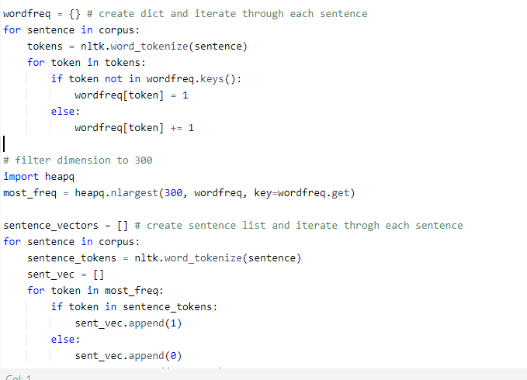
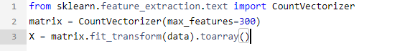
BOW modeling in action

Slide 55
Workshop 2 – Basic text preprocessing

Slide 56
What we have learned so far
Intro to Text Analytic
Data pre-processing
Handling text sentences
Splitting sentences into words
Splitting words into characters
Finding unique words
Intro to Regular Expression and operations
Words to vectors
Word tokenization
Feature extraction
BOW Modelling
ฉันจะไปโรงเรียนนะจ๊ะ

Slide 57
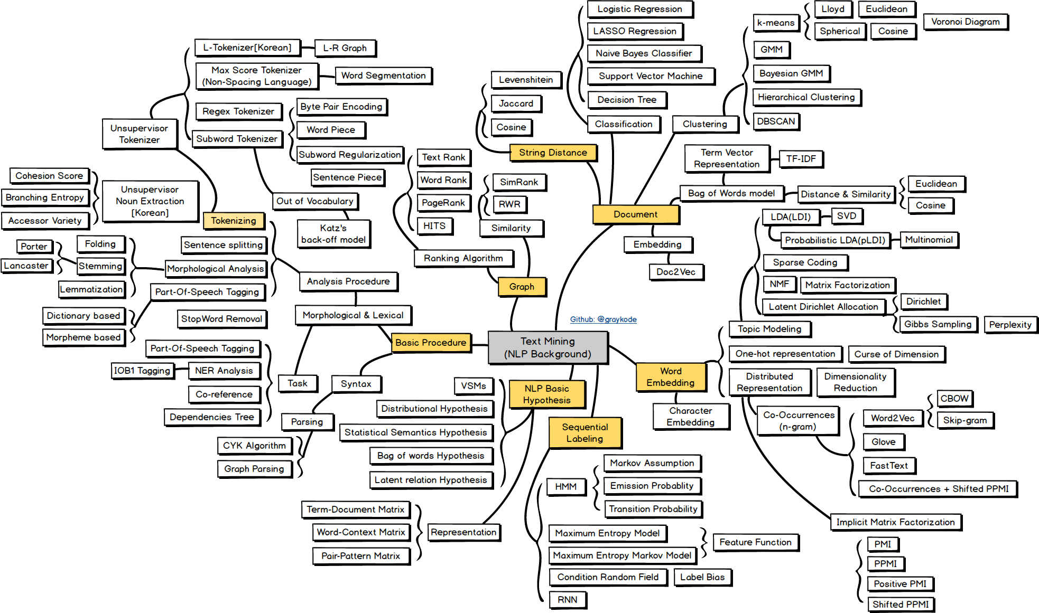
NLP road map
Source:https://github.com/graykode/nlp-roadmap

Slide 58
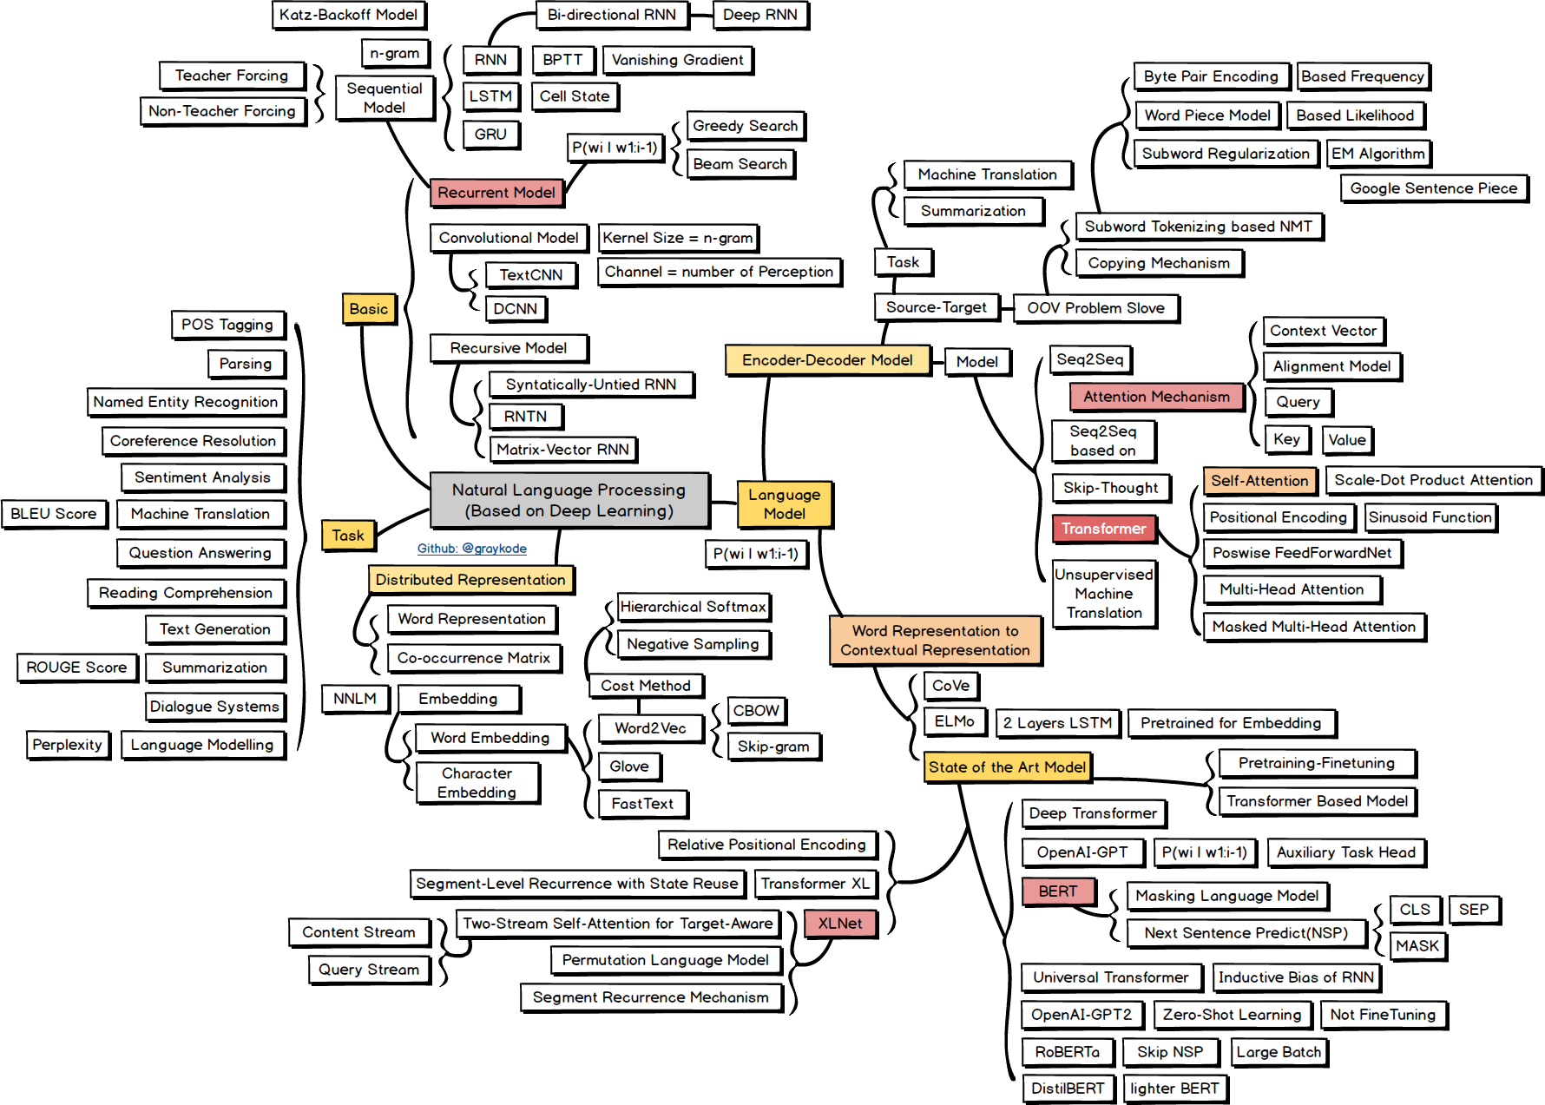
NLP road map (cont.)
Source: https://github.com/graykode/nlp-roadmap

Slide 59
Case study 2021 / NLP application in Action
AI chat bot with Stress detection
Read more at:
https://arxiv.org/abs/1911.00133

Slide 60
Conversational Agents
AKA. Dialogue System, Dialogue Agents, Chatbots
Personal Assistants on phones or other platforms
Alexa, SIRI, Google Assistant, Cortana
Playing music, setting times and clock
Chatting for fun
Booking, scheduling reservation
Clinical uses for mental heath (like my project)

Slide 61
Conversational Agents (cont.)
Chatbots
Mimic informal human chatting
For fun, even for therapy
Task-based
Personal assistant
Book seat in restaurant, movie theater, flights

Slide 62
Chatbot Arch.
Rule-based
Pattern-action rules (ELIZA)
Corpus-based(data-driven)
Information Retrieval
Model-based (My chatbot)

Slide 63



AI Chatbot with
Stress Detection
Group name: FTW_SD
Presenter: Pakin Kampeera (612115005)
Aoxue Gui (612115501)
Project Advisor: Dr. Pree Thiengburanathum

Slide 64
Background
Factors that affect people’s active medical treatment:
Cost
Inconvenience of making an appointment
Obstacles to confiding in strangers
Stress hurts human health. (Hathaway, 2012)
The medical expenses invested to alleviate
people's psychological problems are far from
enough worldwide. (United Nations, 2019)
The pandemic has caused a surge in the number of people calling the mental health hotline. (CDC, 2020)
Most people have stress problems.
(Mental Health Foundation, 2018; APA, 2020; United Nations, 2019; KFF, 2020 )

Slide 65
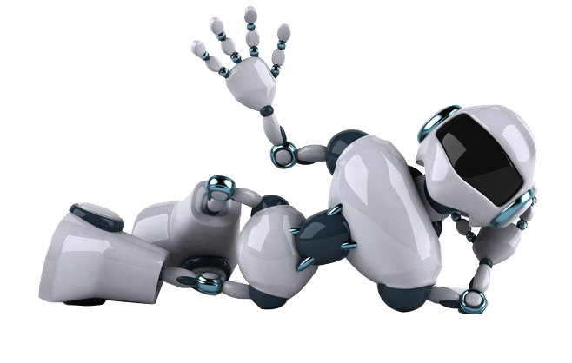
Motivation
we hope to develop a "self-help" tool to let limited psychological counselling services help those who need it more
Aim
Develop a chatbot to detect the user stress during communication and a dashboard to visually shows the statistical data.

Slide 66

Feature Overview
06.
Report generate
05.
View own stress at last 6 months information in line chart.
Data cleaning, Data preprocessing, Data analysis
Analyze sentences.
07.
Notification
View notification message.

Slide 67

Feature Overview
06.
Report generate
Generate intuitive report to see stress change during the last six months.
05.
Data cleaning, Data preprocessing, Data analysis
Analyze sentences.
07.
Notification
Send notification message.

Slide 68
Feature Overview
01.
02.
Authentication
Dashboard
Register
Login
Logout
Reset password
View statistic data
View sentences table
Export table to CSV
Search username or message
03.
04.
User management
Facebook messenger Chatbot
View account information
Change user role
Search user account
Communicate with Chatbot

Slide 69
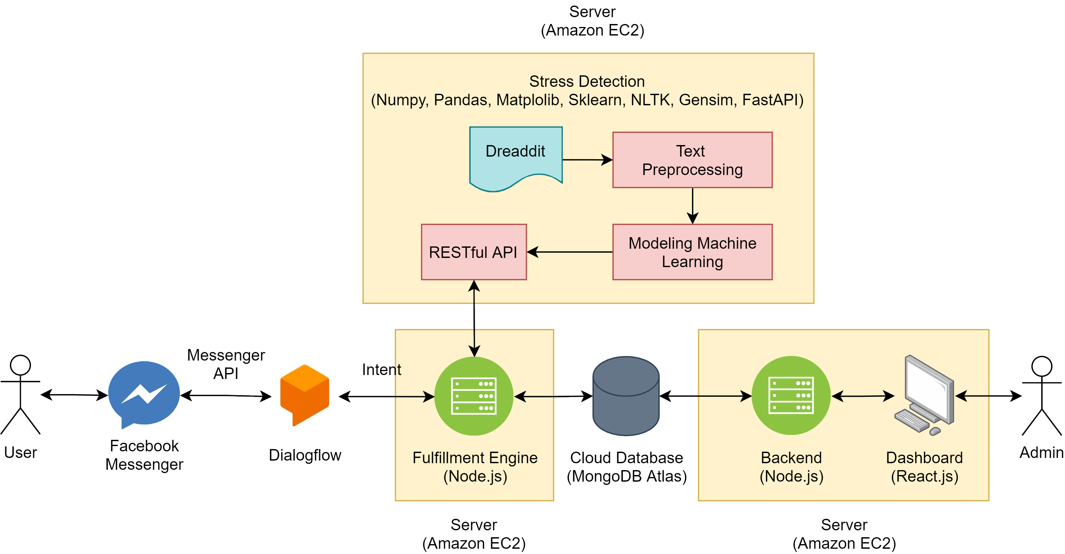
Product Perspective
Analyze whether the sentences are stress, non-stress and cannot tell
Fetch information from database to dissect

Slide 70
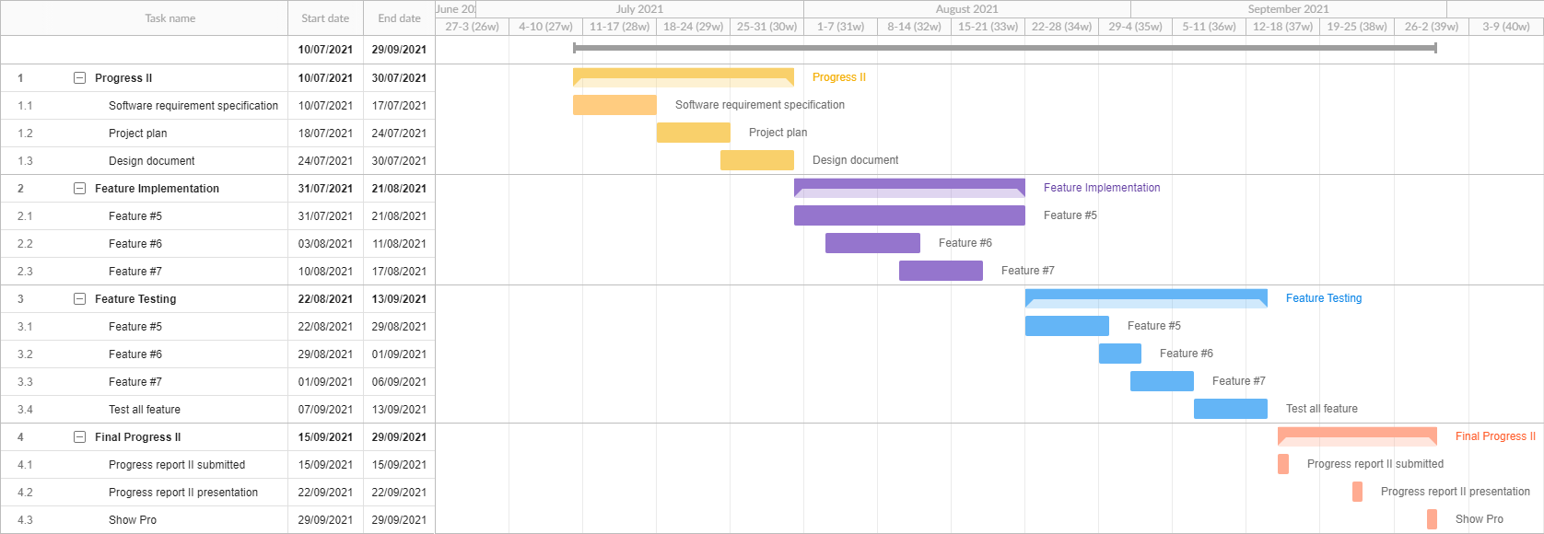
Milestone

Slide 71
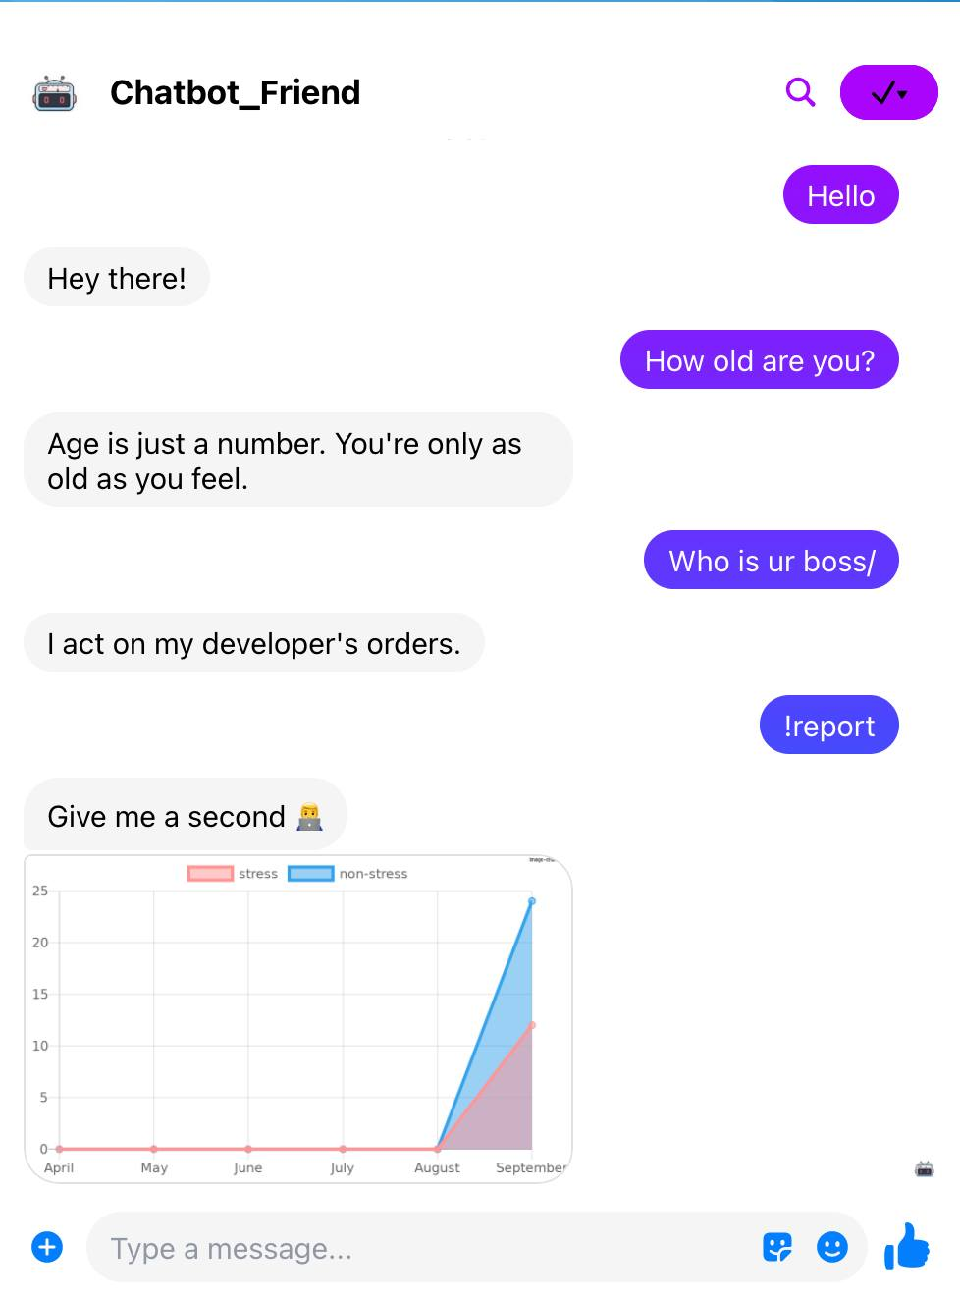
User interface

Slide 72
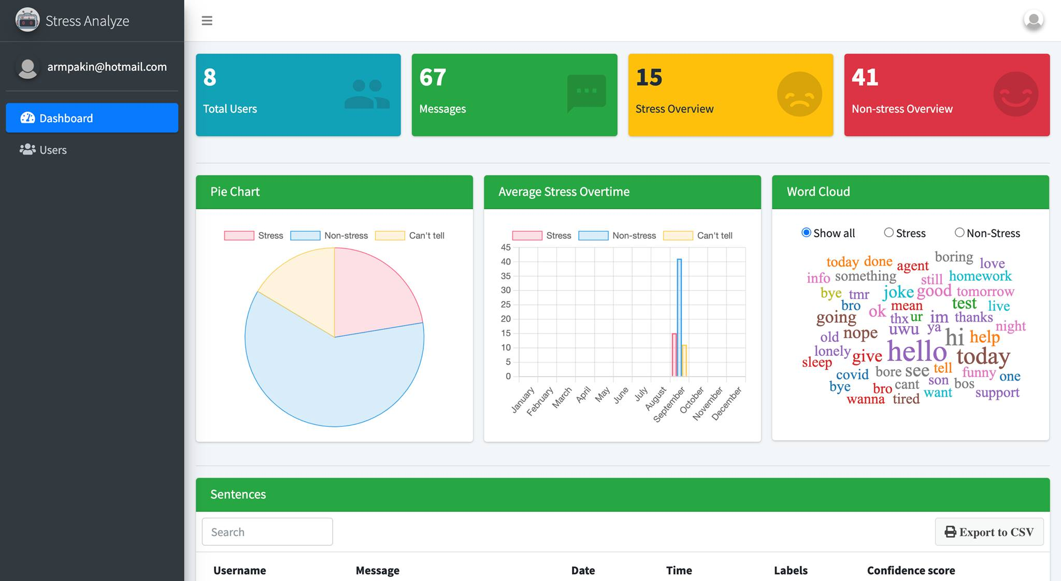
User interface

Slide 73
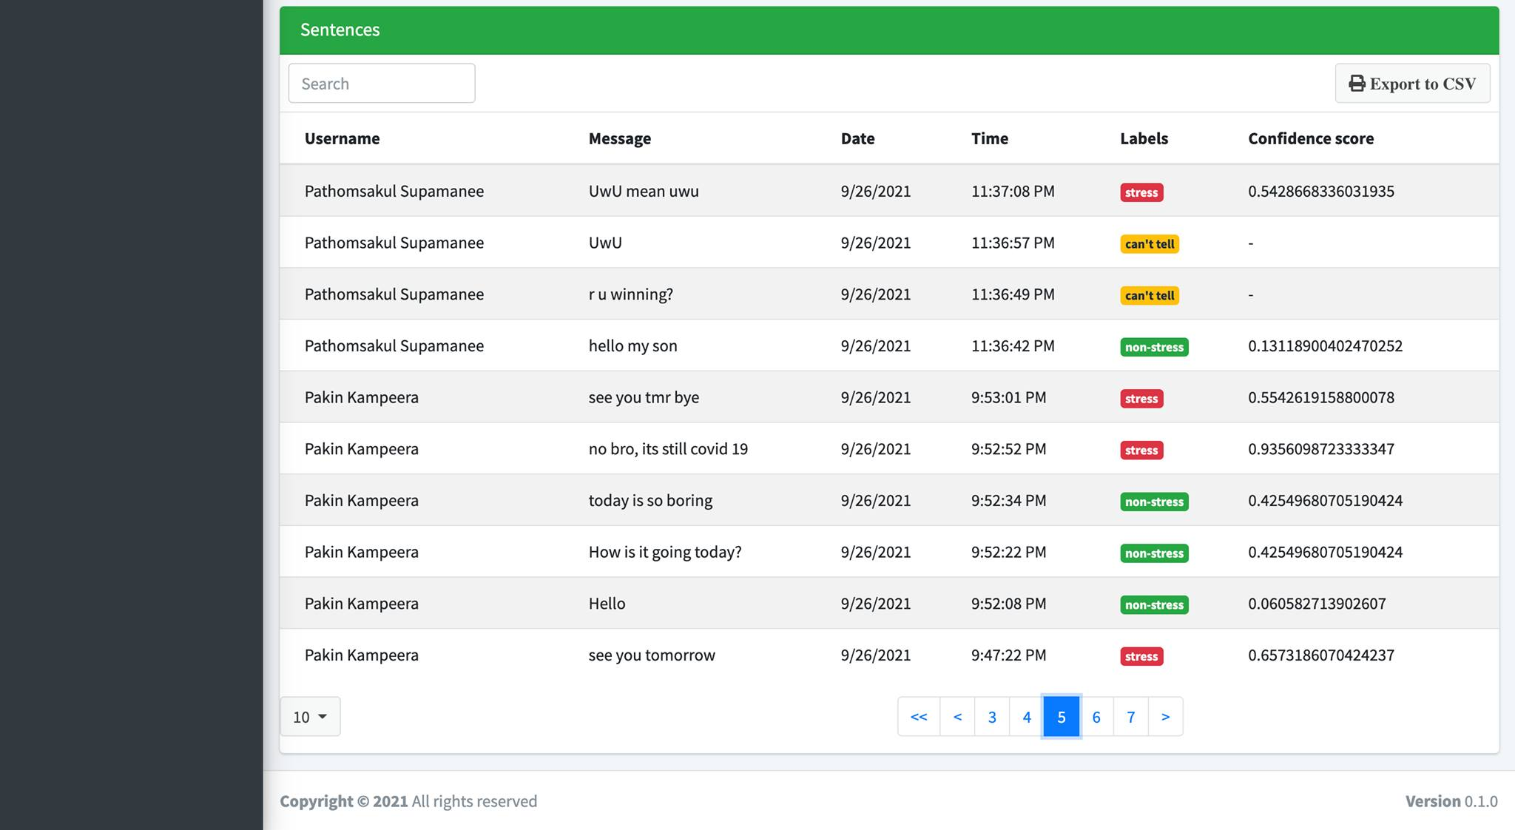
User interface

Slide 74
References
Lane, H., Hapke, H., & Howard, C. (2019). Natural Language Processing in Action: Understanding, analyzing, and generating text with Python (1st edition). Manning.
Turban, E., Delen, D., & Sharda, R. (n.d.). Business Intelligence, Analytics, and Data Science: A Managerial Perspective.
Turcan, E., & McKeown, K. (2019). Dreaddit: A Reddit Dataset for Stress Analysis in Social Media. ArXiv:1911.00133 [Cs]. http://arxiv.org/abs/1911.00133

